Slide 1


English 6
UNIT 6 . OUR TET HOLIDAY
PERIOD 45 : A CLOSER LOOK 1
Welcome to our class
Giáo viên: Lê Minh Dương
Tổ: Ngữ văn –Tiếng Anh

Slide 2

Cook special food
go to a pagoda
Watch fireworks
Things and activities at Tet
Give lucky money
Decorate our house
Visit relatives
Clean the furniture
Notes:
GV yêu cầu HS lên đánh máy trực tiếp trên màn hình chiếu: Kích chuột vào ô cần đánh và đánh chữ trên bàn phím

Slide 3
*Vocabulary:
-to wish: mong ước
-have fun (adj): vui
-fireworks: pháo hoa
-furniture: nội thất, đồ đạc
-special food: thức ăn ngon
-relative: họ hàng
-spring: mùa xuân

Slide 4


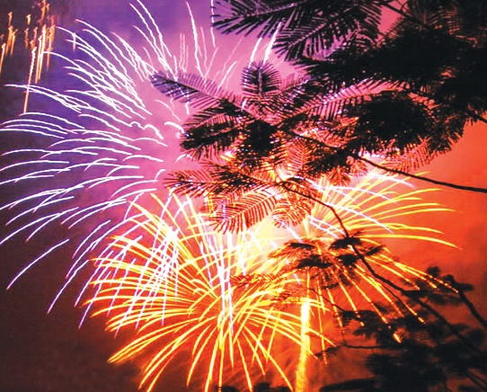
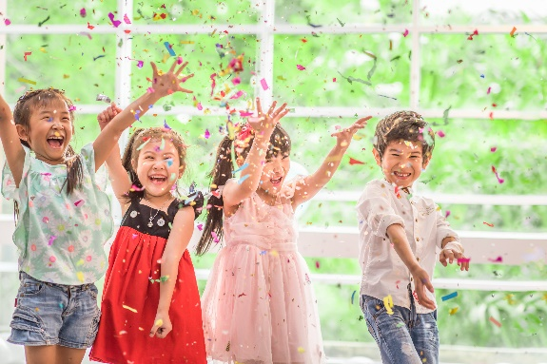
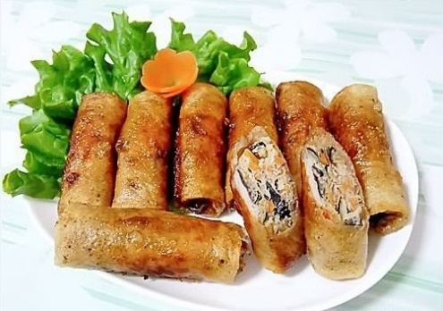
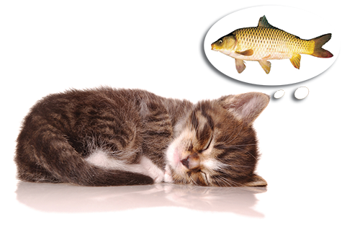
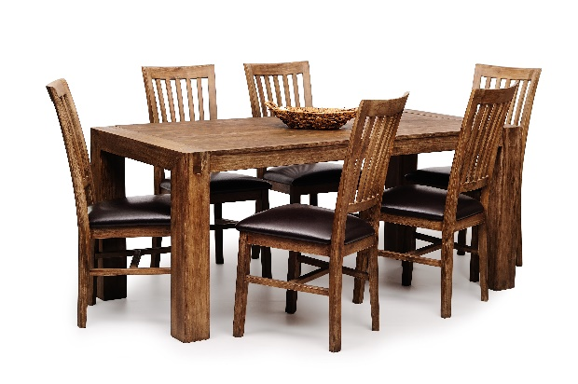
Write the words / phrases in the box under the pictures.
wish
fun
fireworks
special food
furniture
1. fireworks
2. special food
3. fun
1.
2.
3.
4.
4. wish
5. furniture
5.

Slide 5

Match the verbs with the nouns.
Verbs
Nouns
a. a wish
1. have
f. fun
e. relatives
2. visit
b. fireworks
d. lucky money
3. give
c. the furniture
4. make
d. lucky money
a. a wish
5. clean
e. relatives
c. the furniture
f. fun
6. watch
b. fireworks

Slide 6

Complete the sentences with the words in the box.
shopping
celebrate
clean
food
peach
1.
In Viet Nam, we
celebrate Tet in January or February.
Tet in January or February.
At Tet, we decorate our houses with
peach flowers.
2.
flowers.
3.
Children should help their parents to
clean their houses.
their houses.
before Tet.
4.
People do a lot of
shopping before Tet.
5.
My mother usually cooks special
during Tet.
food during Tet.

Slide 7


Pronunciation
/s/ and /ʃ/

Slide 8


Listen and repeat the words.
shopping
special
rice
spring
wish
celebrate

Slide 9


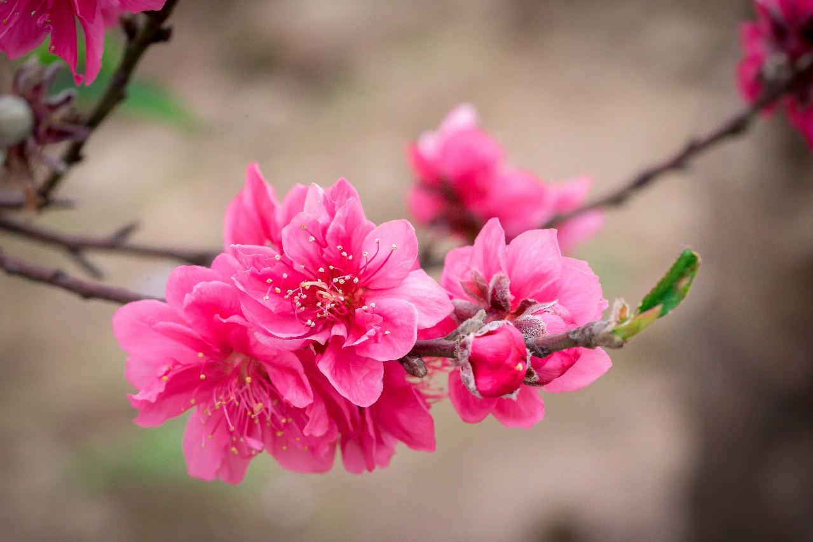
Listen and repeat the poem. Pay attention to the sounds /s/ and /ʃ/ in the underlined words.
Spring is coming!
Tet is coming!
She sells peach flowers.
Her cheeks shine.
Her eyes smile.
Her smile is shy.
She sells peach flowers.

Slide 10

CẢM ƠN QUÝ THẦY CÔ
CÁC EM HỌC SINH ĐÃ CHÚ Ý LẮNG NGHE

